Slide 1
Lab4

Slide 2
DML-SQL
SELECT
INSERT
UPDATE
DELETE
MERGE

Slide 3
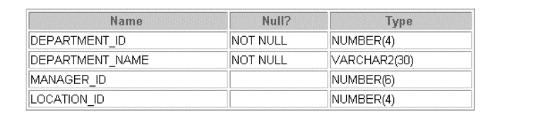
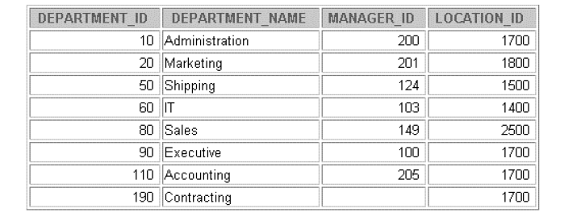
Create the following tables with appropriate PK AND FK & insert the values-department

Slide 4
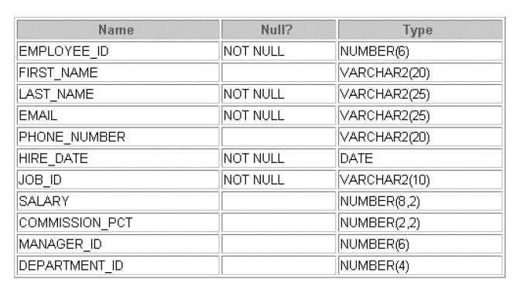
Employee table & insert values into the table

Slide 5

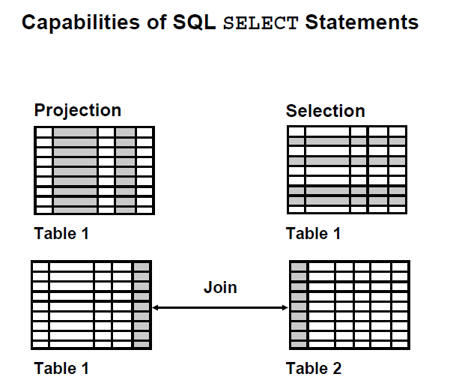

Slide 6
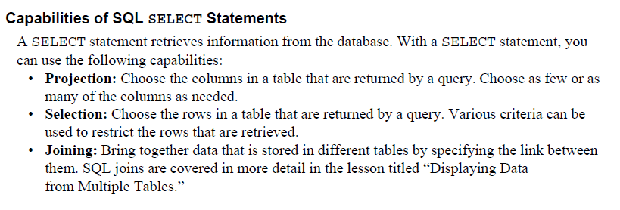

Slide 7
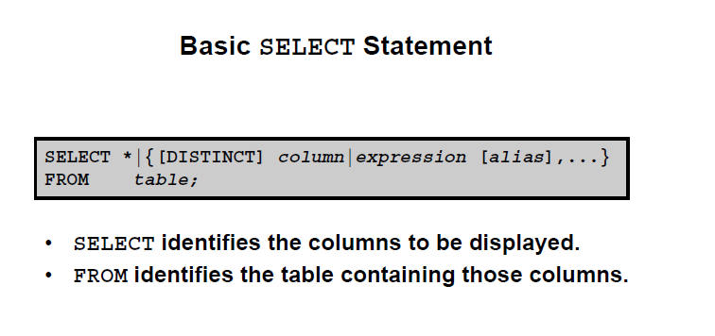
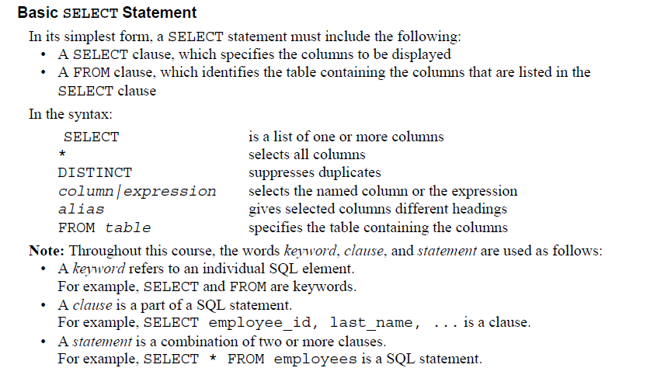

Slide 8
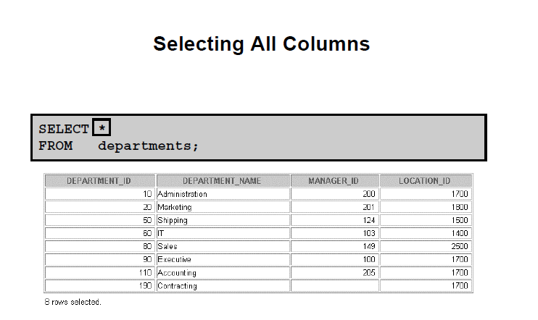

Slide 9
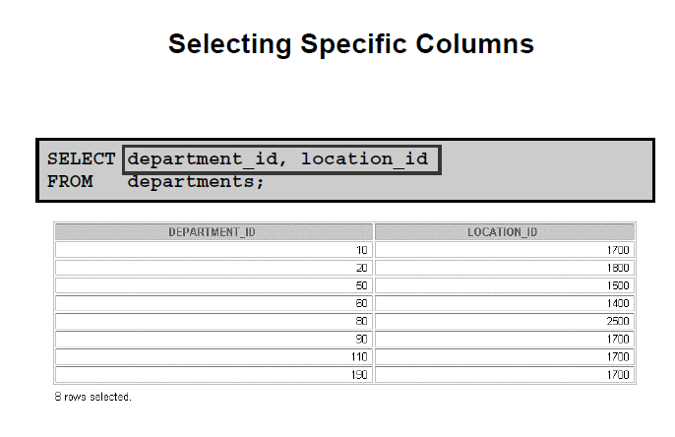

Slide 10
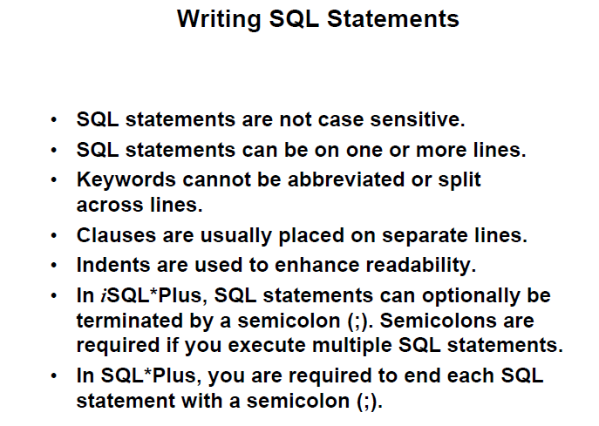

Slide 11
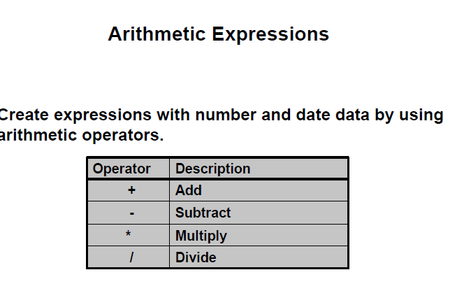

Slide 12
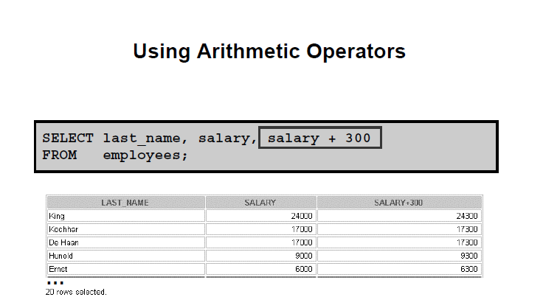
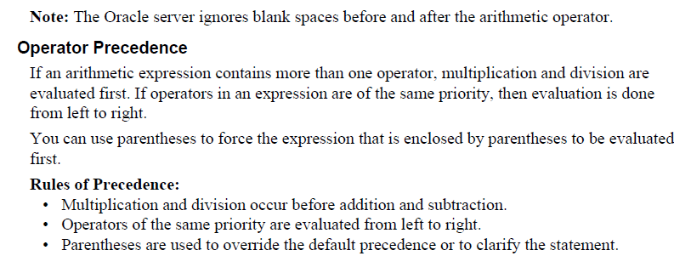

Slide 13
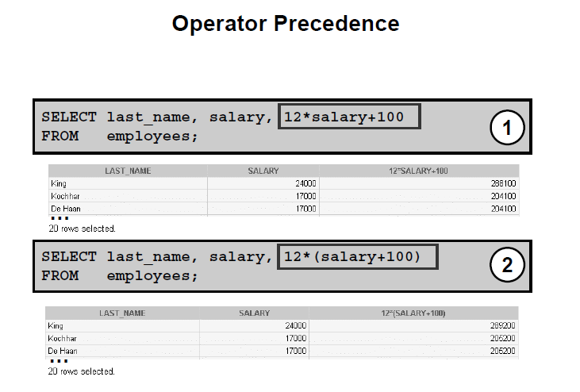


Slide 14
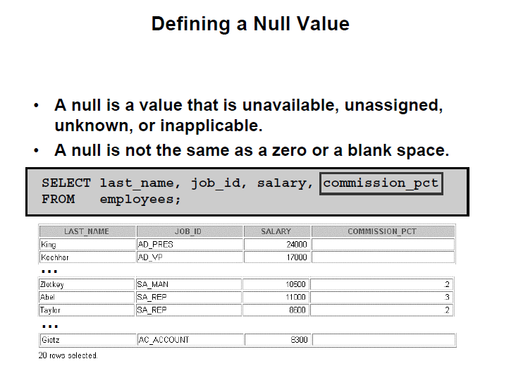
Insert some commission_pct for some employees and then execute this query

Slide 15
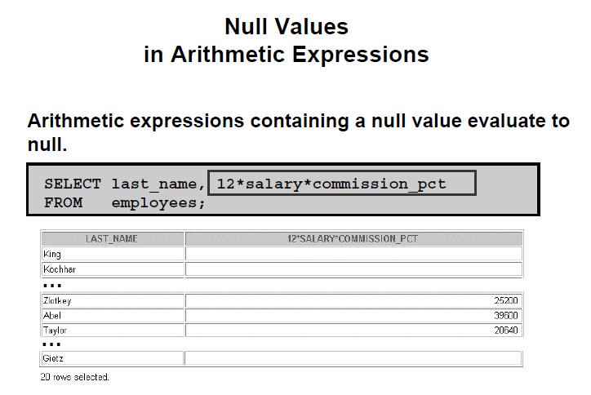

Slide 16
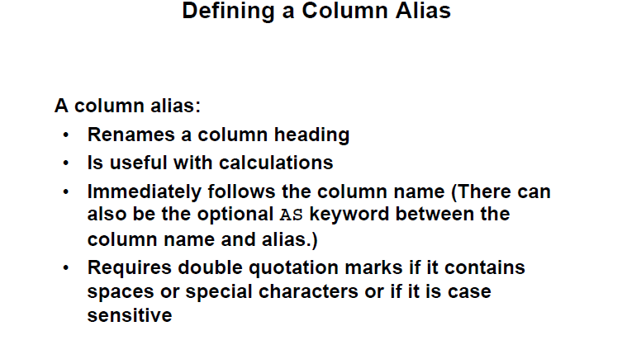

Slide 17
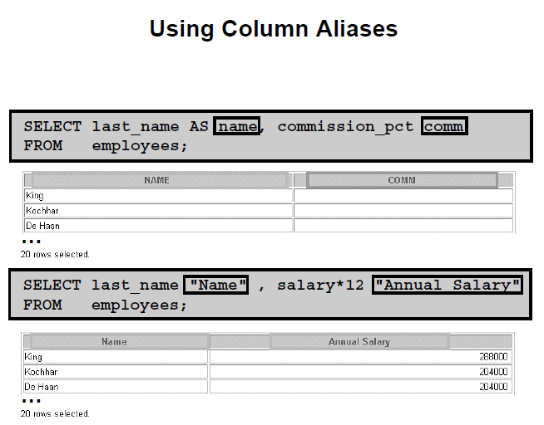

Slide 18
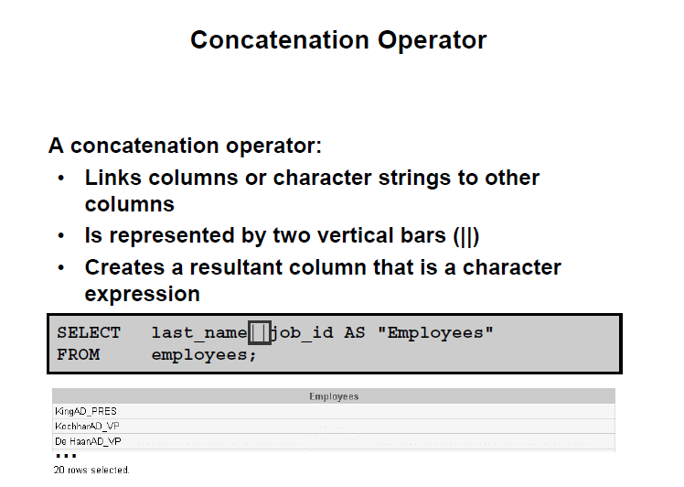

Slide 19
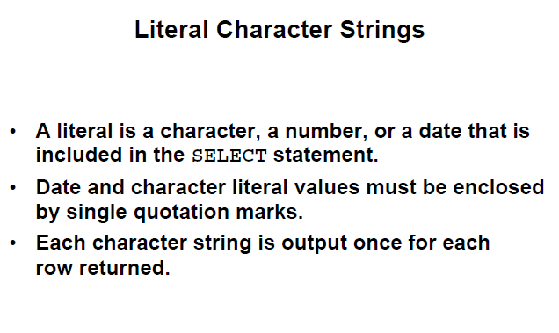
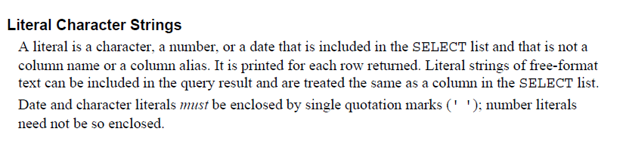

Slide 20
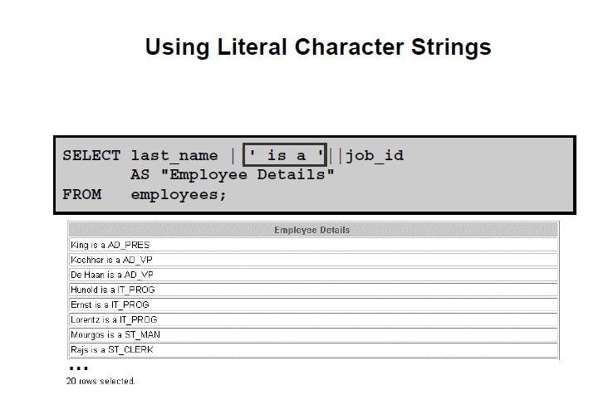

Slide 21
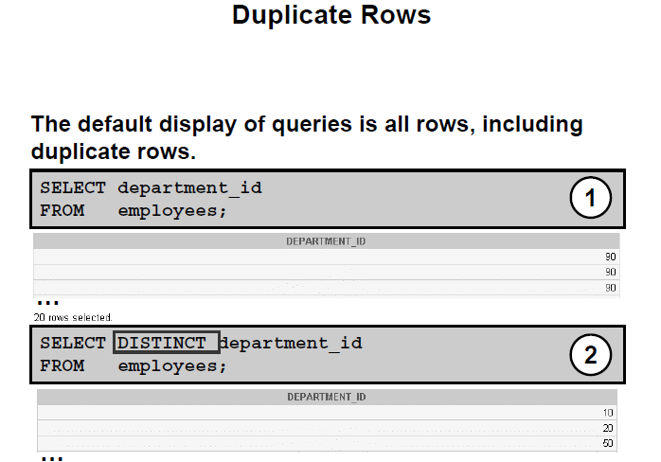

Slide 22
Exercise
1. The HR department wants a query to display the last name, job code, hire date, and employee number for each employee, with employee number appearing first. Provide an alias STARTDATE for the HIRE_DATE column.
The HR department needs a query to display all unique job codes from the EMPLOYEES table.
The HR department wants more descriptive column headings for its report on employees Name the column
headings Emp #, Employee, Job, and Hire Date, respectively.
The HR department has requested a report of all employees and their job IDs. Display the last name concatenated with the job ID (separated by a comma and space) and name the column Employee and Title.

Slide 23
Restricting and Sorting Data
Objectives
After completing this lesson, you should be able to do the following:
• Limit the rows that are retrieved by a query
• Sort the rows that are retrieved by a query

Slide 24
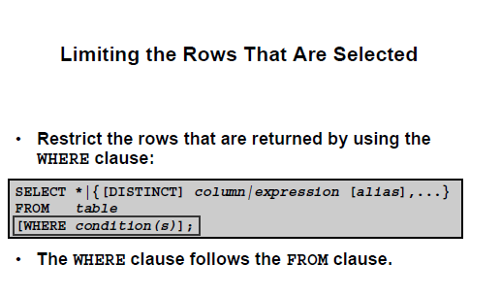
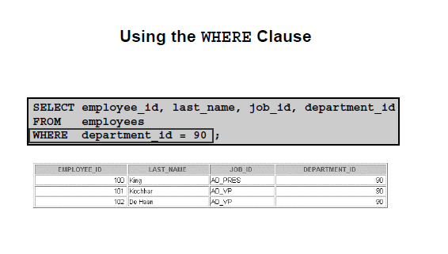

Slide 25
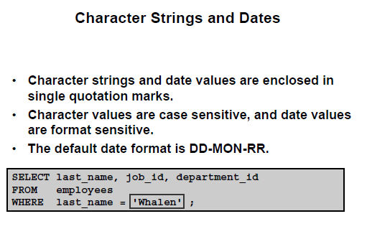
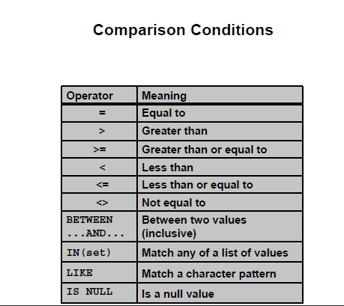
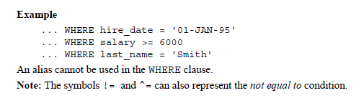

Slide 26
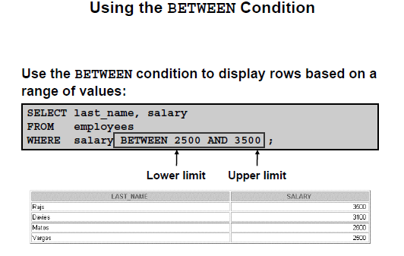

Slide 27
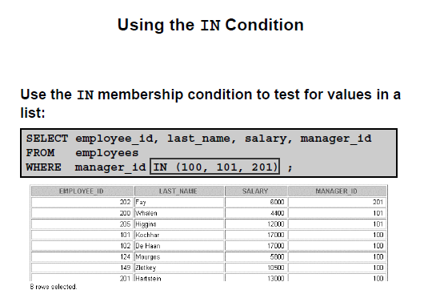
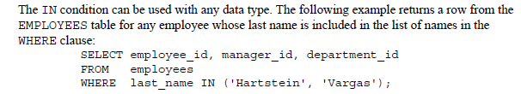

Slide 28
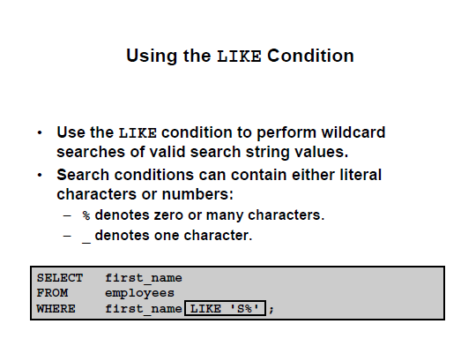
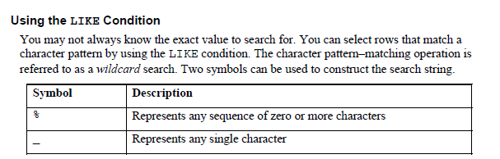

Slide 29
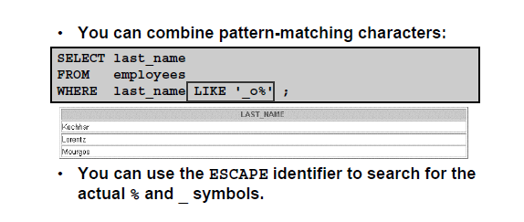
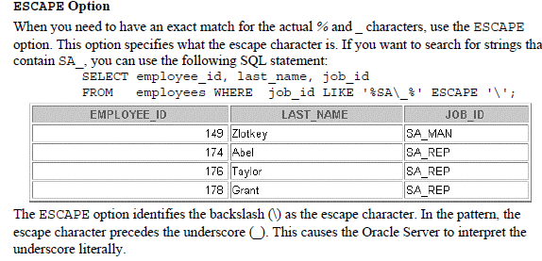

Slide 30
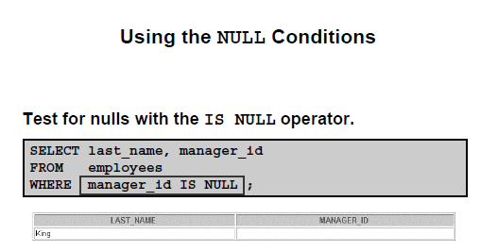
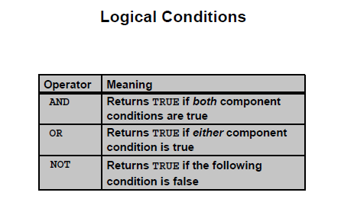

Slide 31
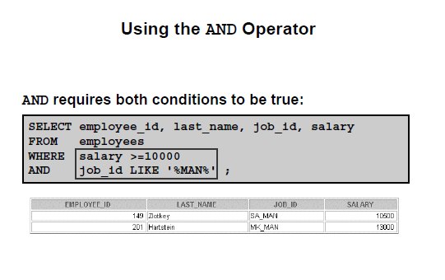
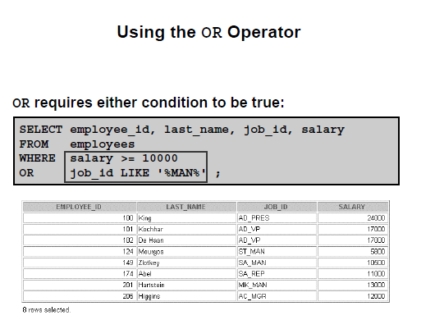

Slide 32
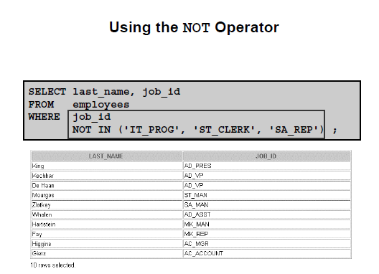
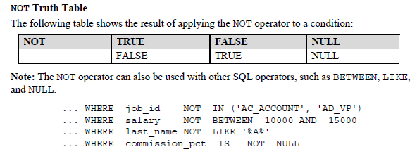

Slide 33
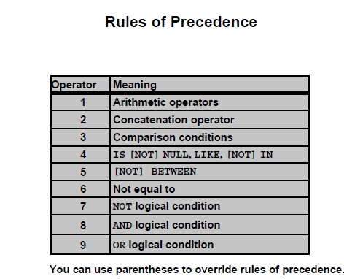


Slide 34
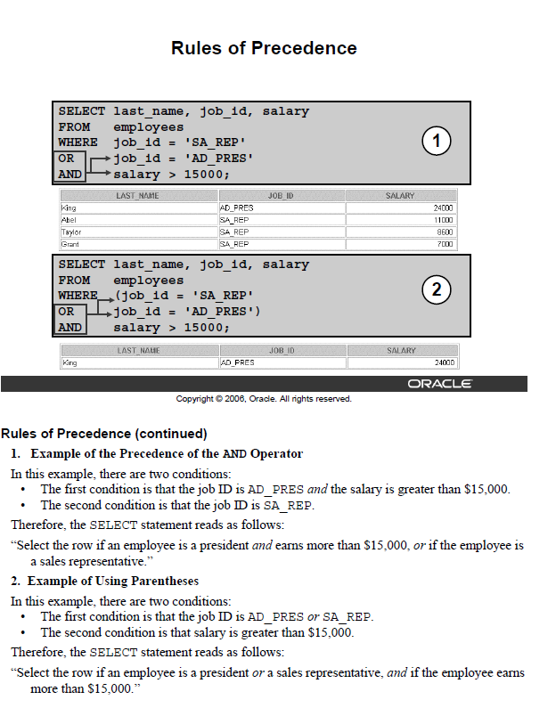

Slide 35
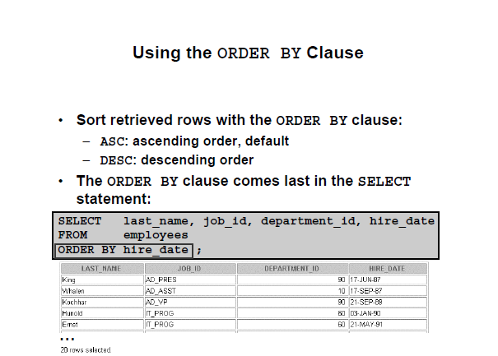
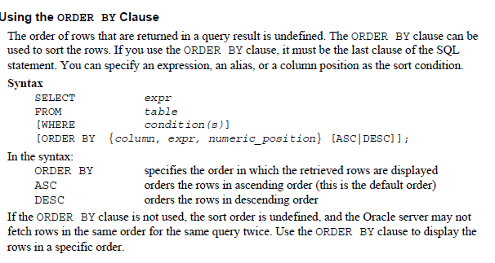

Slide 36
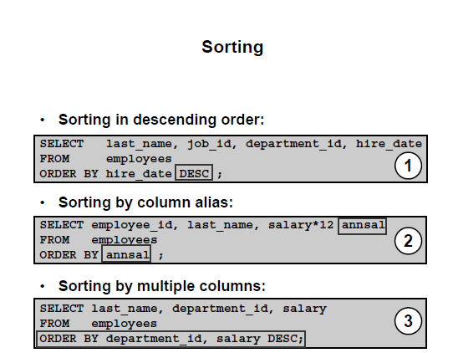

Slide 37
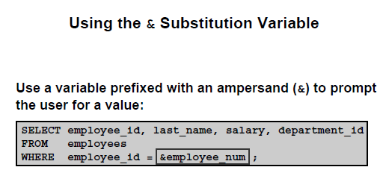
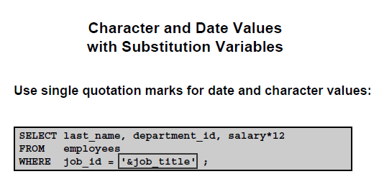

Slide 38
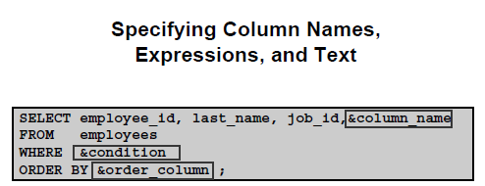
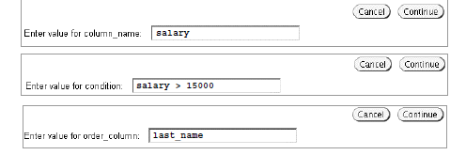


Slide 39


Slide 40
EXERCISE
Because of budget issues, the HR department needs a report that displays the last name and salary of employees who earn more than $12,000.
Create a report that displays the last name and department number for employee Number 176.
The HR department needs to find high-salary and low-salary employees display the last name and salary for any employee whose salary is not in the range of $5,000 to $12,000.
Create a report to display the last name, job ID, and start date for the employees with the last names of Matos and Taylor. Order the query in ascending order by start date.
Display the last name and department number of all employees in departments 20 or 50 in ascending alphabetical order by name
display the last name and salary of employees who earn between $5,000 and $12,000 and are in department 20 or 50.
Create a report to display the last name, salary, and commission of all employees who earn commissions. Sort data in descending order of salary and commissions.

